Slide 1
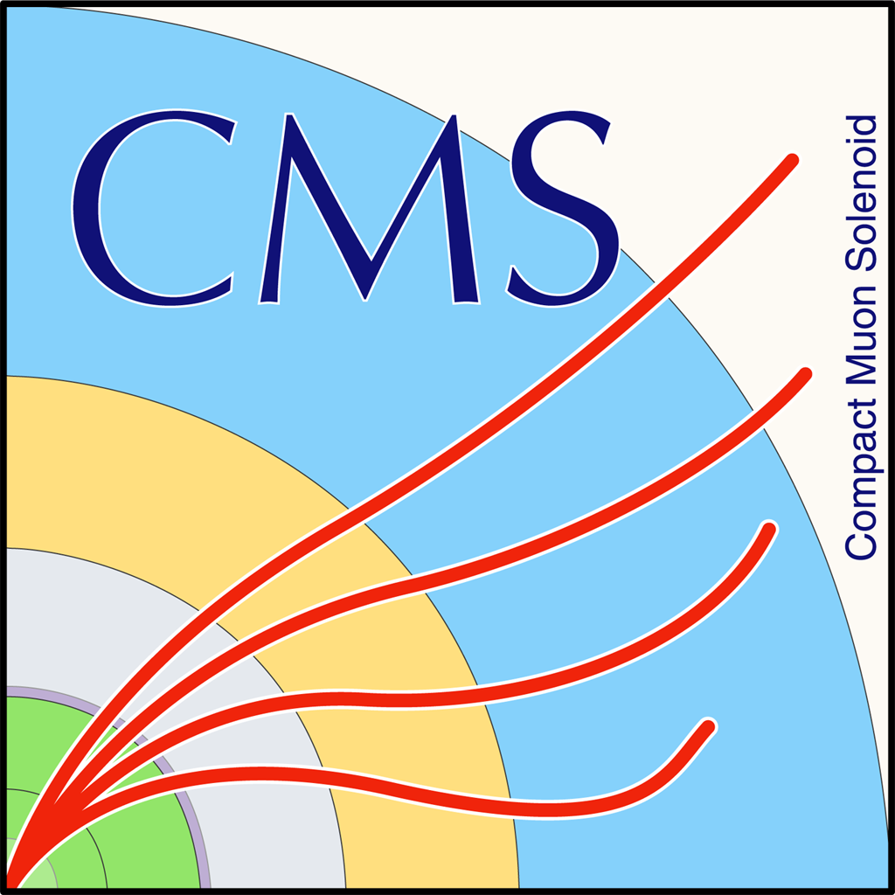

NTUA HEP Cluster CMS Team
George Bakas

Slide 2
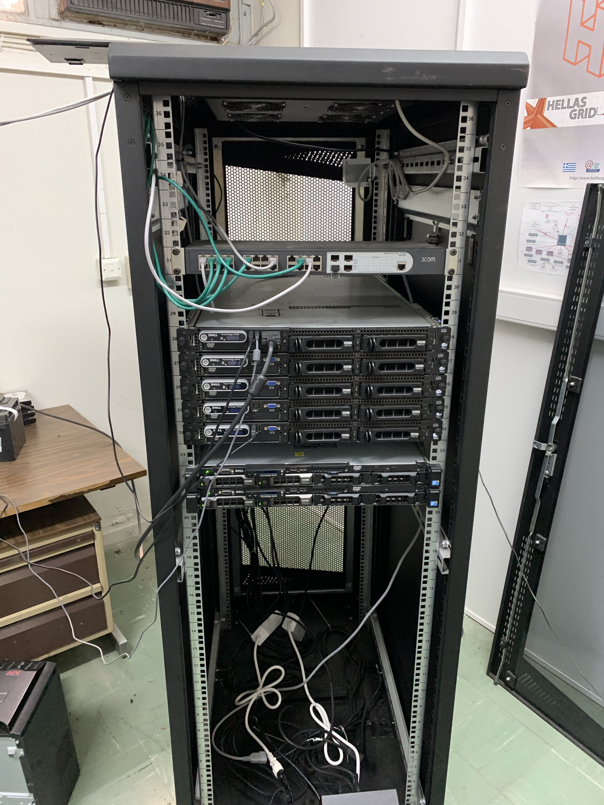
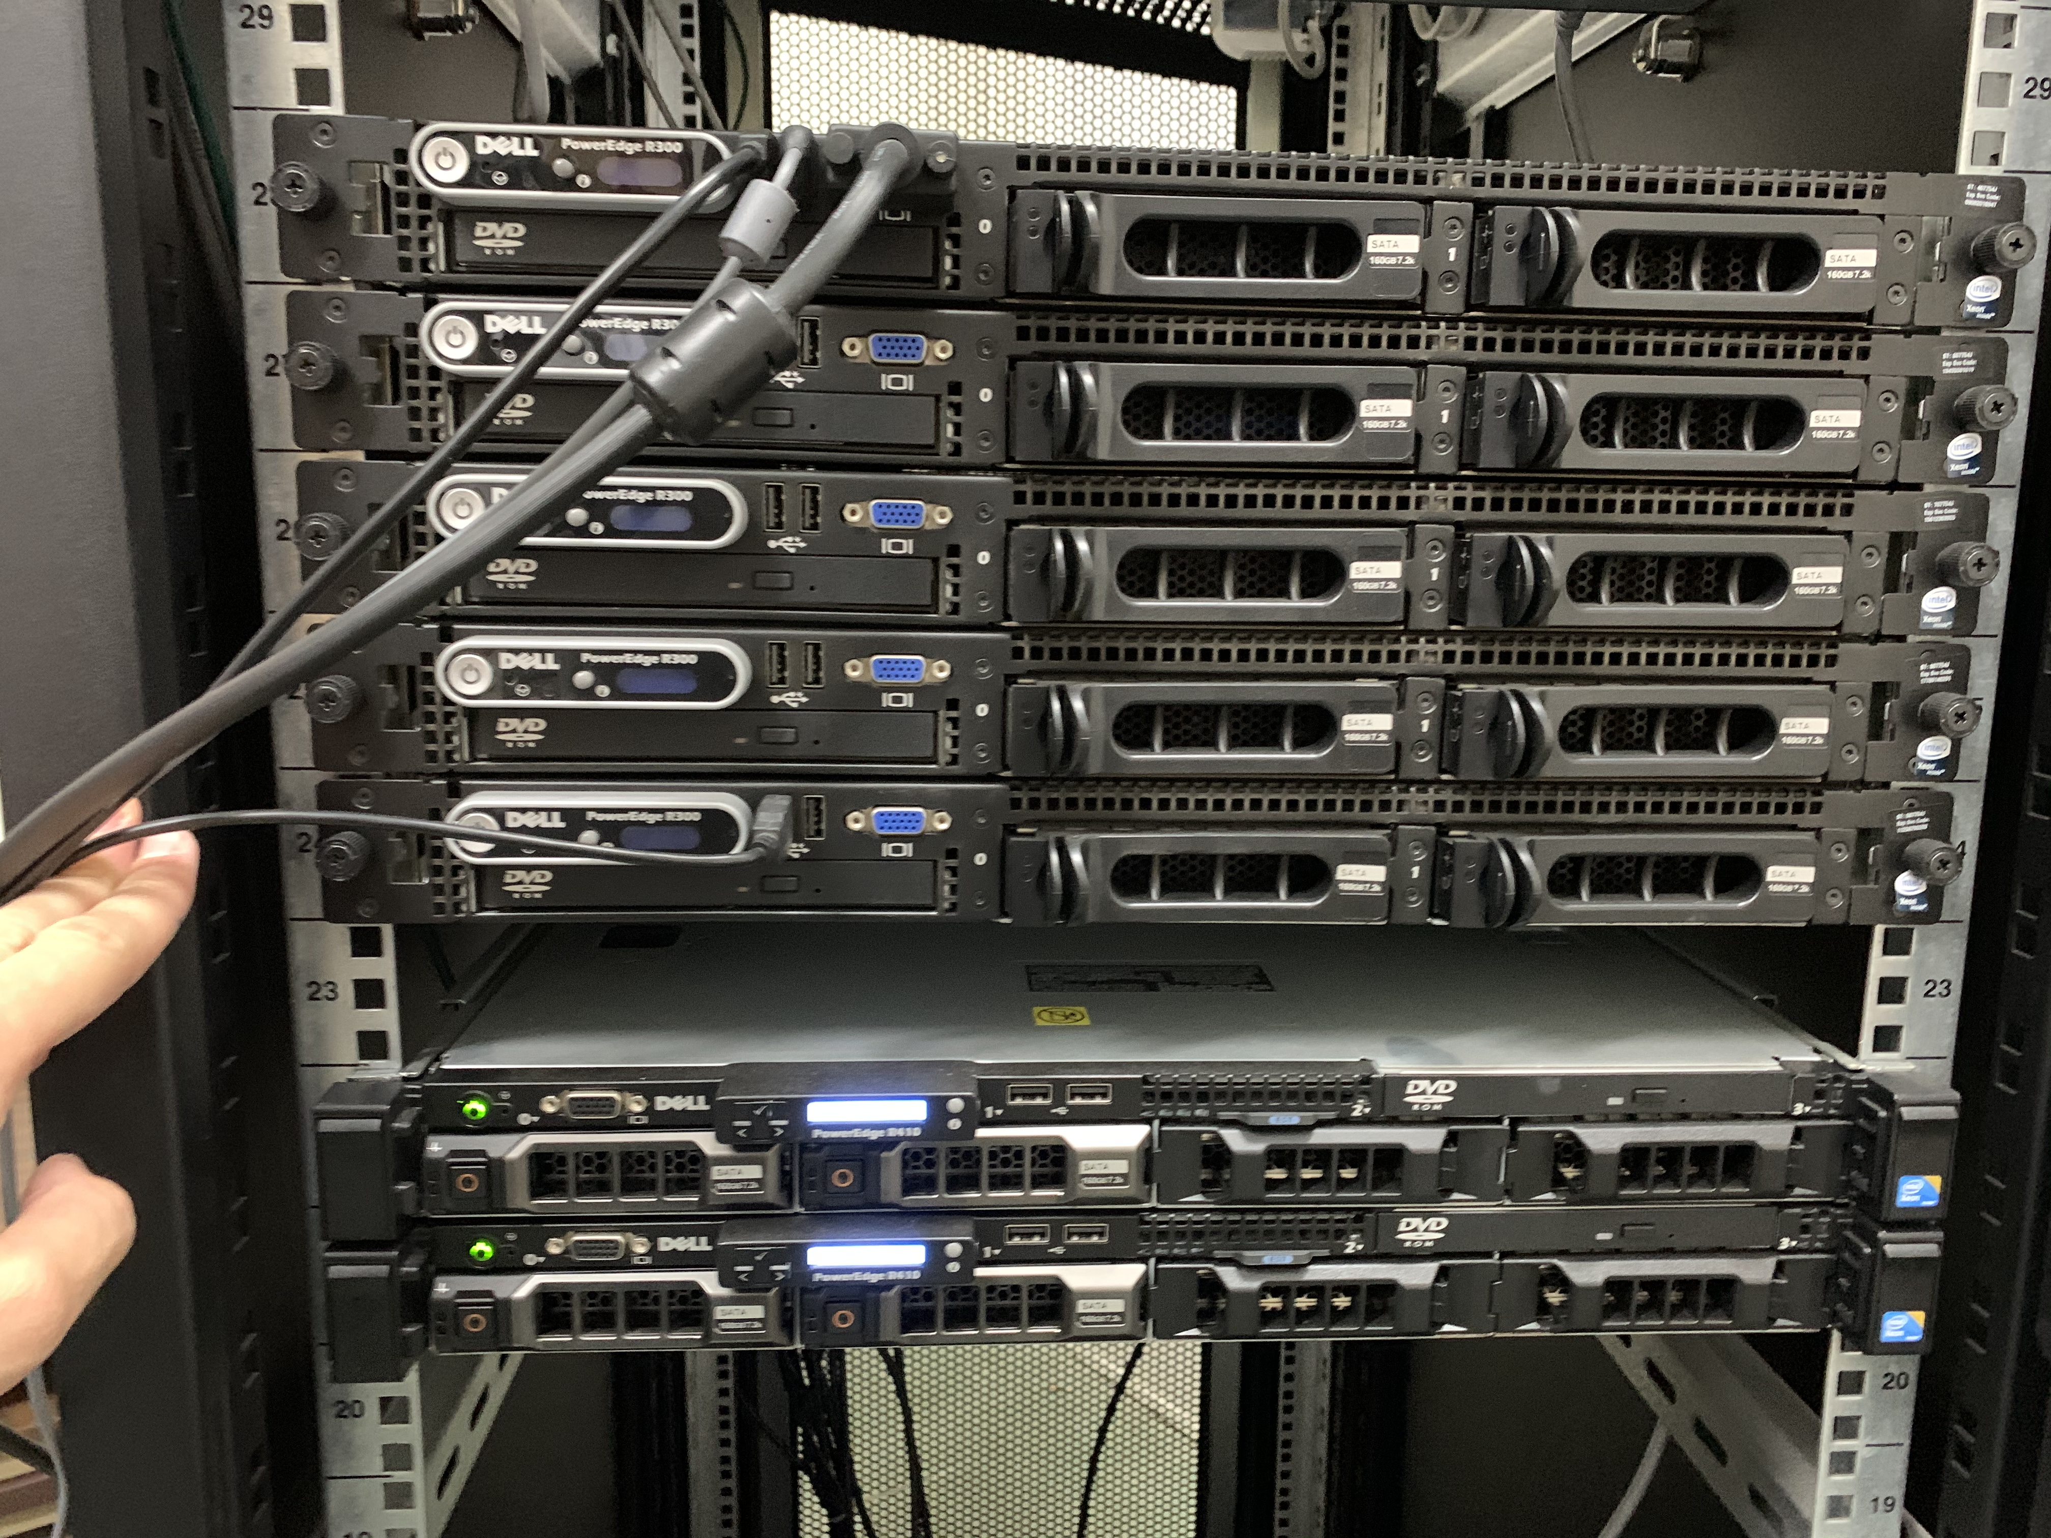
To Do
Network Sockets
Sockets were not connected to NTUA network
Sockets are now connected
Optical Fibre not working → new status on Friday 18/9
Decide on the Operating System
Ubuntu 20 (desktop or server and why?)
Scientific linux (CERN) 7
1 pc is set up with Ubuntu 20
Build ROOT on all computers
Have an ‘e-group’ with user names (NTUA) so that we can connect to the servers
Giannis suggested Round Robin so the servers work like lxplus
We need to talk with the NTUA Network center

